Slide 1
UNIT 6: SOCIETY AND ENVIRONMENT

Slide 2
World Population
Present Population = 7.5 billion
China (1.5 billion people) and India (1.3 billion people) are the most populous countries in the world (19& 18% of the total world population)
Projected population→ 9.7 billion in 2050
It is expected that India will surpass China and become the largest populated country around 2022, while Nigeria’s population will be more than that of United States by 2050

Slide 3
Population growth in India
Economic Survey of India 2018-19
Population growth rate expected to be
less than 1% from 2021-2031
under 0.5% from 2031-2041
Anonymous. 2019. Greying India must delay retirement. The Hindu, Page, 11, July 5, Coimbatore Edn.

Slide 4
Population growth in India
Economic Survey of India 2018-19
The reason being fall in Total Fertility Rate (TFR), which is projected to decline between 2021-2041 & fall below replacement level fertility at 1.8 as early as 2021
Current TFR in 14 out of 22 major States of India is already below the effective Replacement Level Fertility
Anonymous. 2019. Greying India must delay retirement. The Hindu, Page, 11, July 5, Coimbatore Edn.

Slide 5
Population growth in India
Economic Survey of India 2018-19
Size of elderly population >60 yrs age is expected to nearly double from 8.6% in 2011 to 16% by 2041
Size of population 0-19 yrs age is on decline and is likely to drop from as high as 41% in 2011 to 25% by 2041
Anonymous. 2019. Greying India must delay retirement. The Hindu, Page, 11, July 5, Coimbatore Edn.

Slide 6
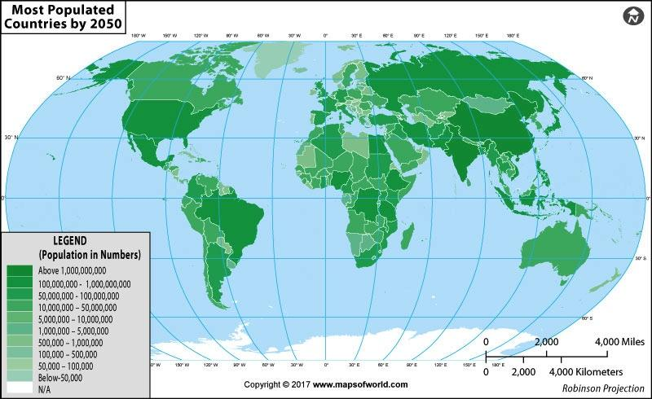
Population projection
By 2050, six countries are expected to exceed 300 million: China, India, Indonesia, Nigeria, Pakistan, and the USA.

Slide 7
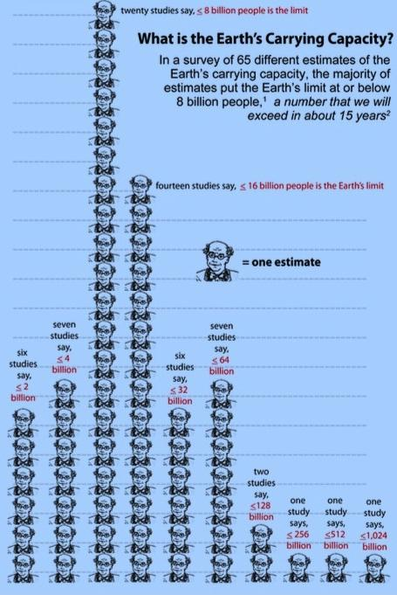
An elephant in the room!!
Overpopulation- Where the number of human population exceeds the earth’s carrying capacity.
Carrying capacity is the maximum size of population that the earth can support indefinitely in terms of space and availability of other natural resources.
We already consume five times more than that the planet can supply; most of the studies showcasing earth’s carrying capacity is 8 billion people, almost equal to the current 7.5 billion!!!
Picture courtesy: Cohen, J. E. (2003). Human population: the next half century. [Research Support, U.S. Gov’t, Non-P.H.S.]. Science, 302(5648), 1172-1175. doi: 10.1126/science.1088665

Slide 8
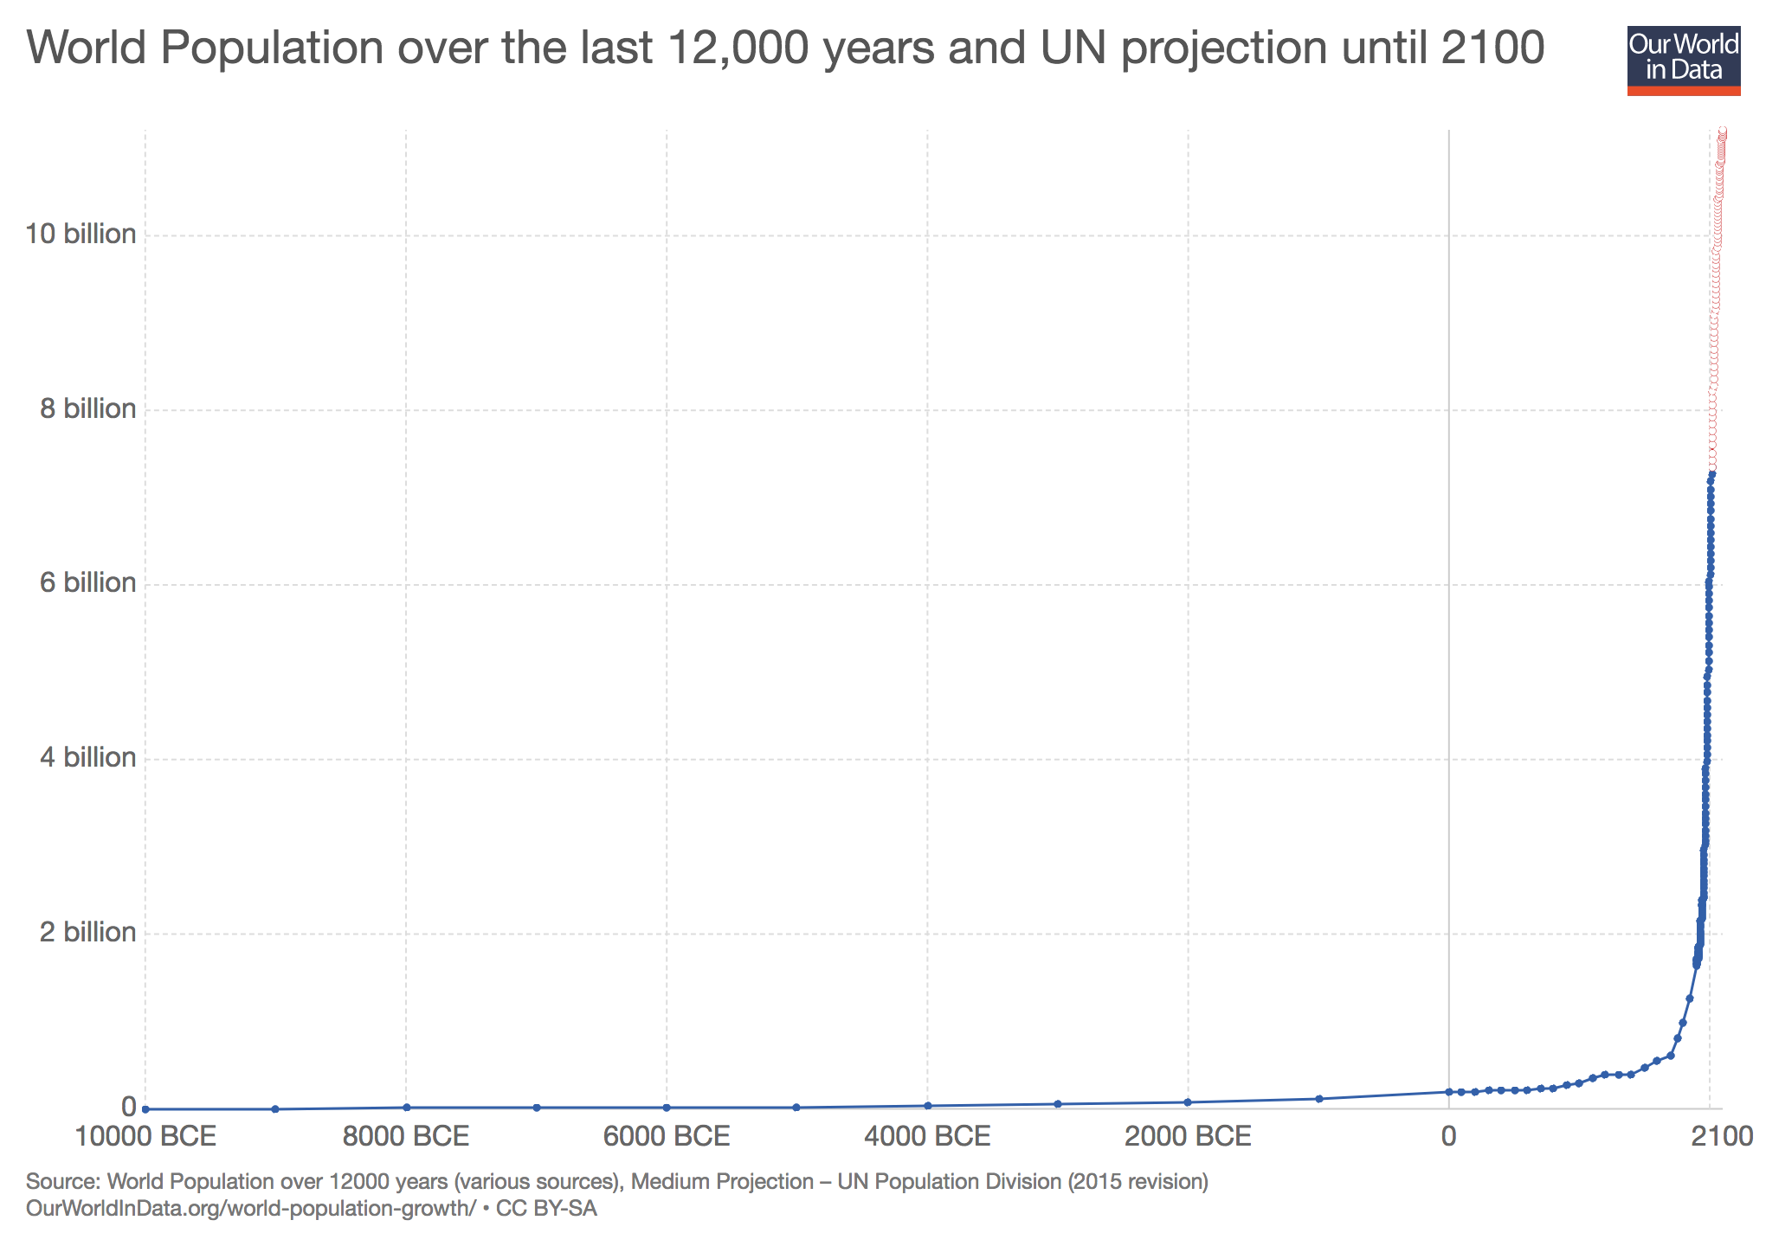
World Population growth
"The world has enough for everyone's need, but not enough for everyone's greed.” M.K. Gandhi

Slide 9
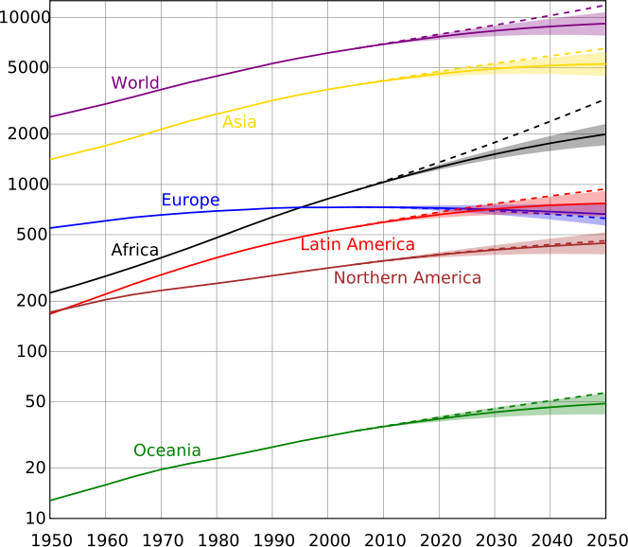
World Population 20-21st Centuries (in mi.)

Slide 10
Population: Terminologies and definitions
Birth Rate = no. of live births/1000
Death Rate = no. of deaths/1000
Natural Increase (%) = 100 x (birth rate - death rate)/total Population
Net migration (%) = 100 x (immigration - emigration)/total Population
Growth Rate (%) = natural increase + net migration
Doubling Time: Yrs. for population to double at current growth rate
The total fertility rate (TFR) = avg. no. of children a woman would have over her lifetime.
Age Dependency Ratio = (No. of people under 15 and older than 64)/(No. of people bet. 15-64)
Life expectancy = the average age a person in the population is expected to reach.

Slide 11
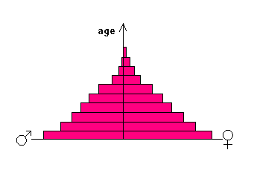
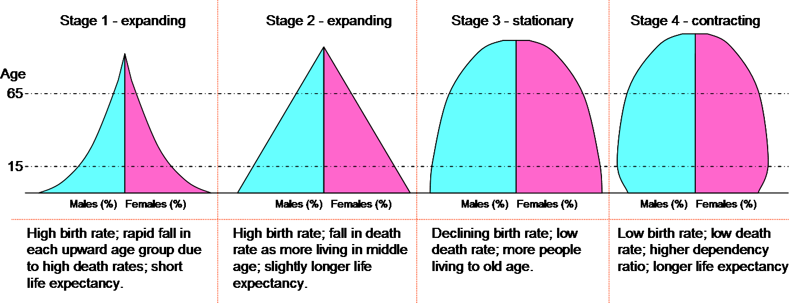
Population Pyramids
Age-Sex Pyramid or Age Structure Diagram

Slide 12
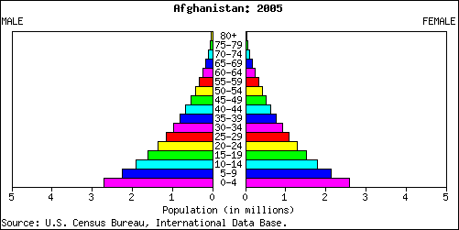
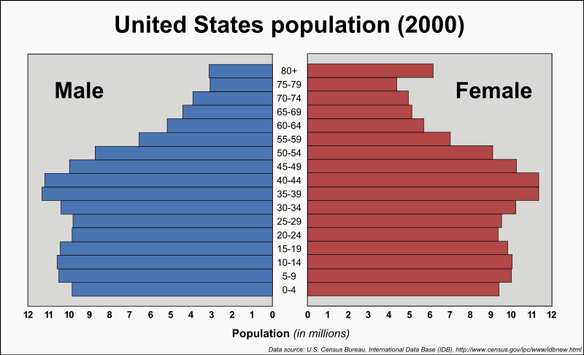
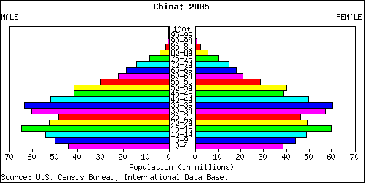
Example: Expanding—Youth Bulge
Example: Stationary—slight bulge & slimming
Example: Contracting—
after massive bulge

Slide 13
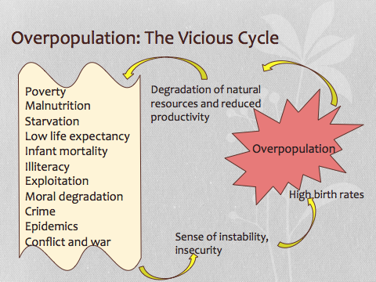

Slide 14
Why is population growth high in underdeveloped countries/regions?
Insecurity due to poverty and socio-political instability (conflict, war, poor law & order):
More children provides a greater sense of security--"more hands to work" and a "retirement plan" especially among agricultural or low wage workers.
Male-dominated uneducated and orthodox society
Girls are looked upon as a liability. Also causes a skewed sex-ratio & child marriage.
Low women literacy, unempowered women
Low knowledge, availability and social acceptance of family planning
Stable families based on traditional values esp. in rural areas (having adequate resources) :
Traditionally, children are looked upon as a sign of prosperity: "gifts of God"; hence, they are not to be limited.
On the contrary, in modern societies and urban areas bringing up of children is viewed as an additional burden, expense or an impediment to women’s careers. Also, high rates of divorce and separation in modern urban societies tend to limit the number of children. But modern urban societies have their own problems.
So society must maintain the stability and good values of traditional family systems, while adopting modern thinking to remove their deficiencies.

Slide 15
Why is population growth high in underdeveloped countries/regions?
Religious reasons
Family planning is considered to be taboo by some religions.
Producing more children is considered virtuous; and the expansion of the faith
A reinterpretation of traditional and religious values in the modern context is necessary.

Slide 16
How to Stop the Population Explosion?
A comprehensive solution is needed. It includes:
Providing good governance
Political, economic and social stability
Fair people-centric policies (incl. economic policies)
Efficient law and order system
Economic measures
Reduce poverty and economic stratification
Provide reasonable and adequate local means of livelihood

Slide 17
How to Stop the Population Explosion?
Providing regular environmentally conscious, value-based education
Empowerment of women in society through awareness measures, women’s support groups, employment and financial independence of women,
Improve universal affordability and social acceptance of family planning methods
Re-interpretation of social values:
The belief that a male-child alone can support parents in their old age and carry forward the family name can be replaced by the idea that male or female issues can support parents and bring good name to their family through their upright character and high achievements.
Prosperity does not mean having more children; it means better children. i.e. Families should focus on better education, upbringing and values in one or two children.
Remove resource-constraints, and overcome natural disasters, etc. to reduce social insecurity, infant mortality and birth-rates

Slide 18
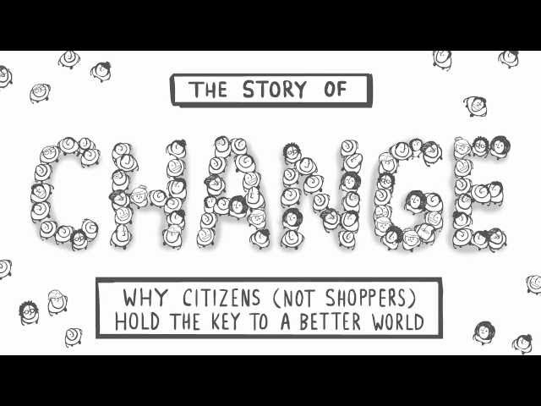
A well-informed population can essentially be the change makers of a society!
They play quintessential roles in a democratic system and help building sustainable societies

Slide 19
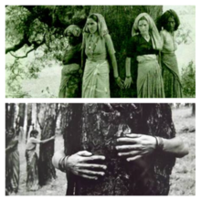
People’s movements to save nature
Chipko movement (Chipko Andolan)
Bishnoi community of Rajasthan started Chipko movement around 260 years back in the early part of the 18th century
People from 84 villages led by a woman Amrita Devi laid down their lives in protecting the trees from being felled on the orders of the King of Jodhpur.
In 1973- Indigenous people of the village of Mandal in the upper Alakananda valley protested and saved the forest trees against government's decision to cut them for a sports-good company
Non violent (inspired from Gandhiji’s) movement by hug or stick to (‘chipko’) trees
Prime figures: Sunder Lal Bahuguna (Environmentalist), Gaura Devi (elderly woman from indigenous community), Mr. Chandi Prasad Bhatt of Dasoli Gram Swarajya Sangh(DGSS)
Picture courtesy: Wikipedia

Slide 20
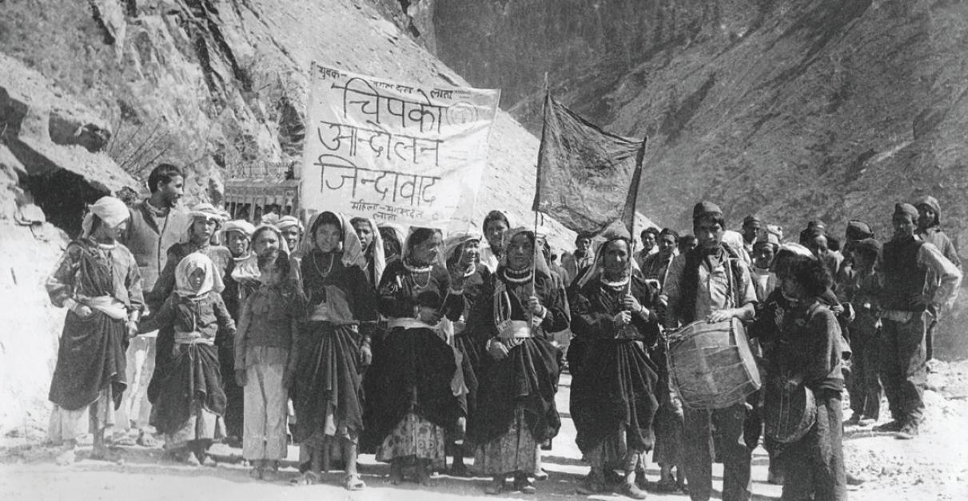
'What do the forests bear? Soil, water and pure air’ the Chipko slogan
“The forest nurtures us like a mother; you will only be able to use your axes on it but you have to use them first on us” Gaura Devi
Chipko is considered as the beginning point in the history of nature conservation in India
Its success triggered similar conservation movements elsewhere in the country
Courtesy: Harmony magazine

Slide 21
Silent valley movement
People’s movement that saved a pristine moist evergreen forest in Kerala’s Palakkad District from being destroyed by a hydroelectric project proposed by the state government in the Kunthi river, a tributary of the Bharathapuzha River
The Kerala State Electricity Board, KSEB proposed the hydroelectric project across the Kunthi river in the pristine forest area to generate electricity for the state of Kerala with the installation of four units of 60 MW each, to Irrigate an additional 100 sq km and boost the economy of the state.
The major impacts of the projects include
Submergence of 8.3 sq km of untouched moist evergreen forest with several species of flora and fauna including endemic species

Slide 22
The Movement...
Citizens from almost all walks of life participated-scientists, researchers, activists, literary figures, journalists, teachers, students and common people
Non violent movements include in the protests include writing letters to the editors of newspapers, organizing seminars, widespread awareness programmes by school going students and local clubs, and drafting petitions and appeals in court and other high offices
Some of the notable personalities involved: Salim Ali, Madhav Gadgil, MS Swaminathan, Sathish Chandran Nair, V.S. Vijayan, MV Krishna Warrier and Sugatha Kumari Kerala Sasthra Sahithya Parishad (people’s science movement) played a vital role in the movement
In 1983 the then Prime Minister of India, Indira Gandhi, decided to abandon the Project and the Silent Valley forests were declared as a National Park.

